Slide 1

How we apply NER to help us reduce the time to process the post/articles
Presenter: Sherry/Eason/John
Date: 2021/05/xx

Slide 2
Agenda
Preface - ML Introduction
Lab – Data Collection & Data Clean
Lab – Choose ML toolkit
Lab – Training & Testing
Lab – Learning from data
Q & A
Notes:
Here is today’s agenda. We will have a few slides to introduce what ML is and what are some of the benefits it can bring to us especially in terms of time taken to complete a task.
Then we will learn how to deal with the real world problem of NER (Name Entity Recognition) step by step using ML.

Slide 3
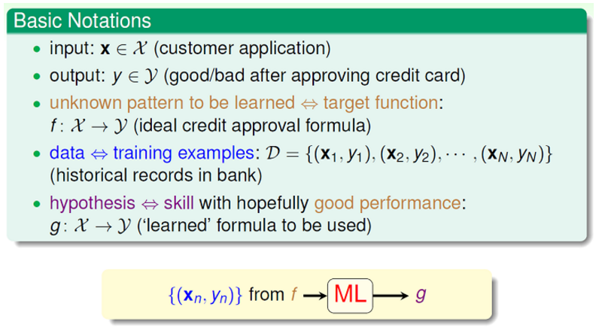
Preface – What’s Machine Learning
Machine Learning is the science (and art) of programming computers so they can learn from data. Here is a slightly more general definition:
Machine Learning is the field of study that gives computers the ability to learn without being explicitly programmed. (Arthur Samuel, 1959)
A computer program is said to learn from experience E with respect to some task T and some performance measure P, if its performance on T, as measured by P, improves with experience E. (Tom Mitchell, 1997)
From Course - Machine Learning Foundations (link)
Notes:
What is ML? It is not magic, but rather math and statistics. You can find many definitions on the internet. In my opinion, I prefer to explain it with just one simple sentence: Use information learned from data to make decisions about our problem.

Slide 4
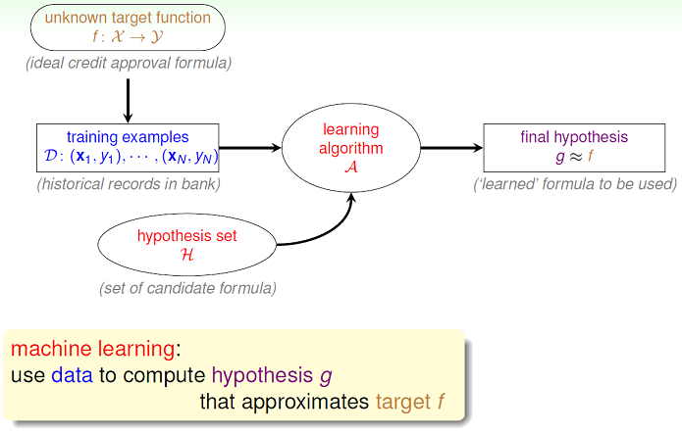

Preface – What’s Machine Learning
a = ?
b = ?
c = ?
X & y
Y
aX + bY = c
X
Notes:
Here is one example of how ML deals with a classification problem. X here refers to features we feed into ML and y refers to the labels we expect ML to tell us.

Slide 5

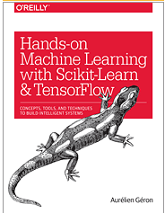
Preface – Why ML?
As we care about how our customers feel about our products, we will have people to check out posts in forums to see if there are any complaints. If there are, we can then deal with those issues and enhance our test processes to improve the quality of our products. In order to accomplish this, we have to locate the object of the complaint and identify the profile a particular customer is not satisfied with. Check out the post below as an example:
Post link
Subject
Description/Symptom
Object
Notes:
Let’s look at a real case of how a customer complains about our product. How long will you take to identify the subject, object and the symptom in this post?
10 sec? 1 minute? For ML, it takes only less than 1s. On reddit alone, we have around ??? such posts per day. Do you think will we have enough time or manpower to digest those articles? Here ML comes to the rescue.

Slide 6
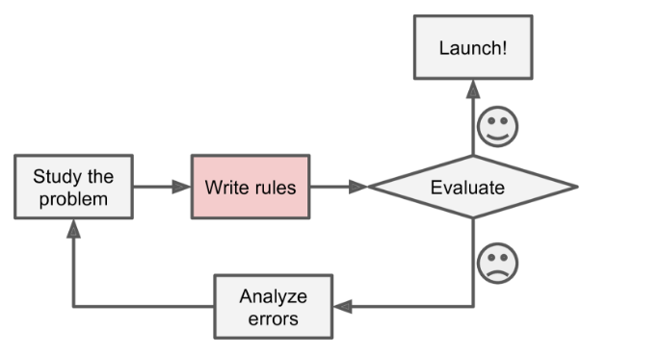

Preface – Why ML?
If you are thinking about creating rules to extract subject/object/symptom from posts on forums, here is the typical process we may go through:
New model of mobile phone
New model of car/handset/BLE
Rule efficiency and effectiveness
Notes:
You may think about writing rules to extract information we want. But what happens if we have a new model of mobile phone? In Google, we have so many different types of cars, handsets, and BLEs, so we have a long list of keywords to match. How should we maintain the rule list for better efficiency and effectiveness?

Slide 7
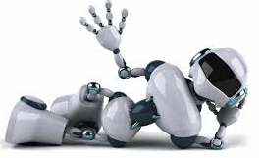

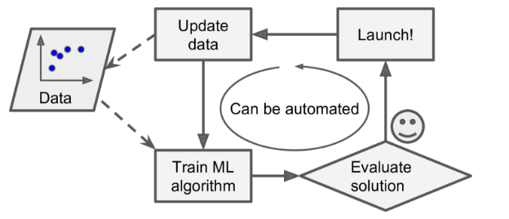
Preface – Why ML?
In contrast, this is a classic NER (Name Entity Recognition) problem and can be handled by the Machine Learning techniques automatically!
Notes:
Actually, NER is a classic problem which can be handled by ML. The benefit of applying ML here is that you only need to prepare the labelling data and ML will handle the rest for you.

Slide 8
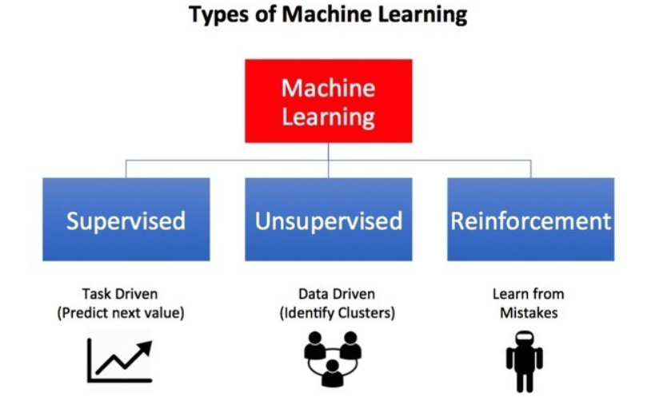
Preface – Types of ML
In Supervised Learning, the training data you feed to the algorithm includes the features and desired solutions, called labels (“Subject”, “Object” etc).
Spam classification
Face recognition
NER
In Unsupervised Learning, we feed in the features into algorithm and the output will categorize the data into a desired number of group.
Recommender system
Anomaly detection
In Reinforcement Learning, we build a Q table by trial and error, and reward the agent to learn the optimal path for better performance.
Video games
Robotics
more

Slide 9
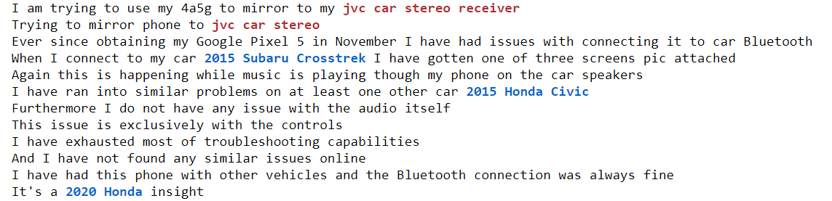
Preface – Labelling data
The labelling result will look like:
Car accessories
Car type/model
Mine is a Nissan Frontier with an aftermarket Kenwood touchscreen radio by the way.
Mine is a Nissan Frontier with an aftermarket Kenwood touchscreen radio by the way.
Machine learning model
Input
Output
Notes:
The first thing we need to do when we carry out any ML task is to prepare data. From our problem, we have to label every sentence to let ML know which part of the sentence to extract. Here we are interested in two kinds of name entities, namely car models and car accessories.

Slide 10
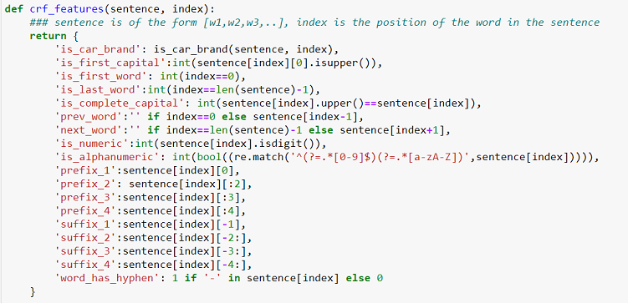
Preface – CRF
First ML model we are going to play with is CRF - Conditional random fields (CRFs) are a class of statistical modeling method often applied in pattern recognition and machine learning and used for structured prediction.
O
C
A
，
，
Is_car_brand
Is_car_brand
Is_car_brand
Others
Car type/model
Car accessories
Notes:
The first machine learning model we are going to play with is called CRF (Conditional random fields). It is a Discriminative Probabilistic Classifier which means it learns from condition probabilities. Take the feature “is_car_brand” for example, CRF will learn the conditional probabilities among all labels, which O standing for others, C standing for Car type/model and A standing for accessories. Take the word “TOYOTA” for example, it is a car brand and is given the label “C”. So CRF will learn that when a word contains a car brand, it will be very likely to be labelled “C”.
This kind of feature is called a state feature. There is another kind of feature called transition feature which makes predictions based on a learned probability.
For example, what is the likelihood of assigning a C label when the previous label is C, O or A?

Slide 11

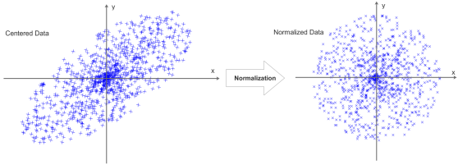
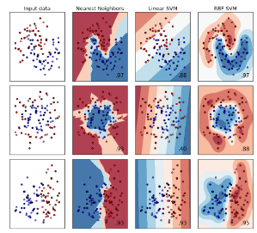

Practice – How to adopt ML
Here we are going to use a practical example to explain how we adopt ML to solve real world problems. For our problem, we want to implement a Classifier to handle the NER problem:
Feature Extraction
Normalization
Training
Evaluation
Raw Data
Notes:
Actually, machine learning flow is an iterative process. It all starts with data collection and labelling. We will explain them step by step.

Slide 12
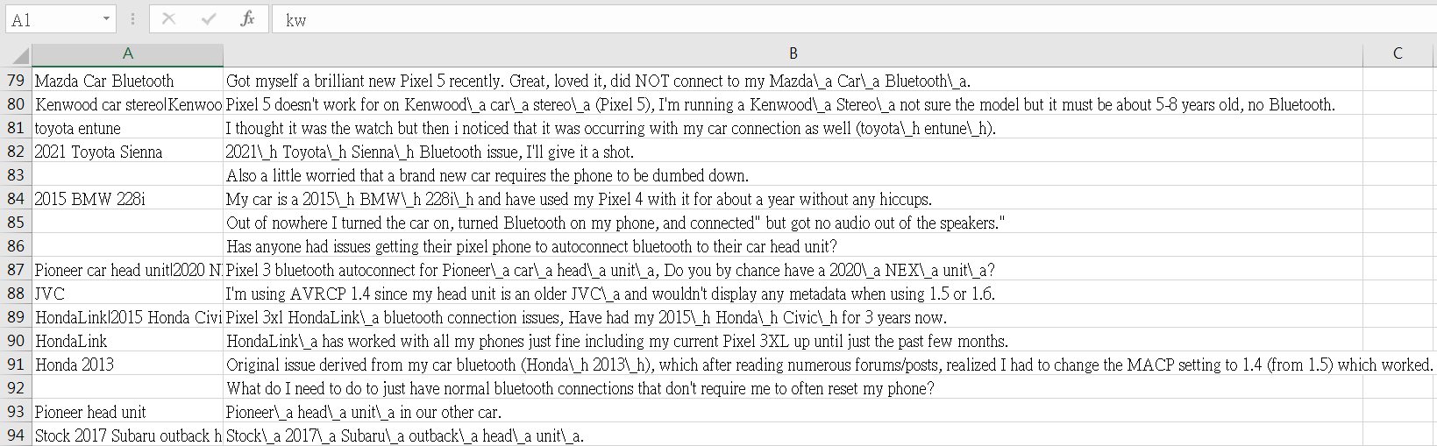
Data Source (reddit)
Feature Extraction
The first step of ML is to Collect data, Clean data and Label data
We collected data from DB of explorer1 which mainly came from reddit.
We manually labeled around 114 sentences.
Total 1,797 O label(s); 147 C label(s) and 67 A label(s)
(Ref. C:\John\EclipseNTU\GPhishing\GPhishing\src\tk\PTDown.groovy)

Slide 13
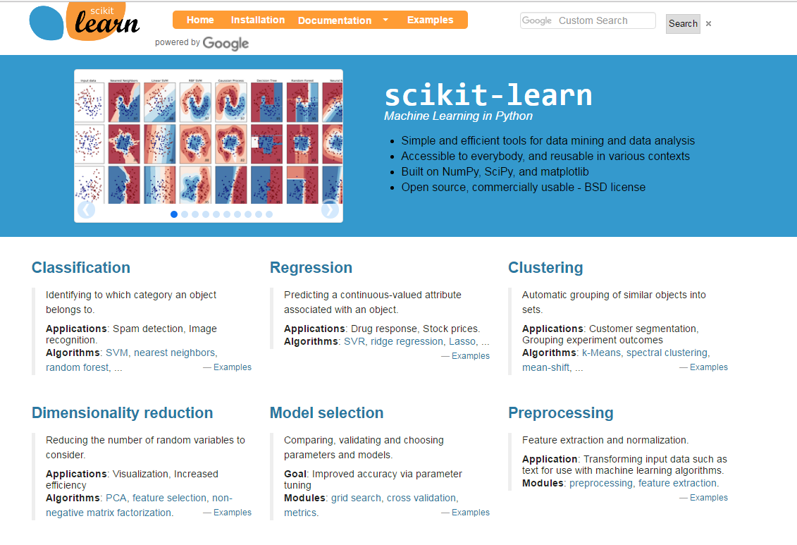
Machine Learning Toolkit
Training
Then we have to decide which machine learning toolkit to use and translate our raw data into corresponding training/testing data which can be fed into it.
Here we chose sklearn-crfsuite as our machine learning toolkit which is written in Python, as most of us are familiar with Python.
Notes:
We selected sklearn-crfsuite which is a sub project of a famous python machine learning package called scikit-learn. They share the same API signatures which means we can leverage on many existing utilities from scikit-learn, such as metrics packages, to measure the performance of our model.

Slide 14
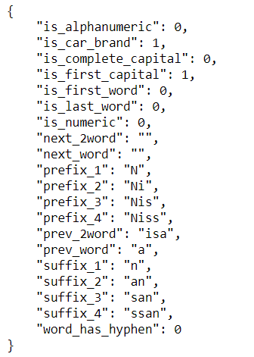
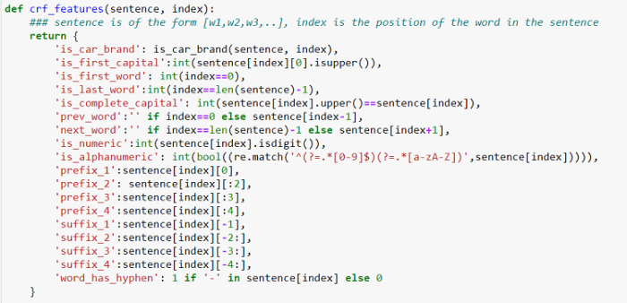
Feature Engineering
Feature Extraction
We develop a function “crf_features” to extract features from sentences. Let’s check out how a sentence is translated into features that can be used by CRF:
Sent: Mine is a Nissan\_h Frontier\_h with an aftermarket Kenwood\_a touchscreen\_a radio\_a by the way.
1. Separate features and target labels
words: ['Mine', 'is', 'a', 'Nissan', 'Frontier', 'with', 'an', 'aftermarket', 'Kenwood', 'touchscreen', 'radio', 'by', 'the', 'way', '.']
labels: ['o', 'o', 'o', 'c', 'c', 'o', 'o', 'o', 'a', 'a', 'a', 'o', 'o', 'o', 'o']
Nissan
2. Feature extraction
Notes:
Every model has its own definition and template when it comes to features. Here is how we produce the features required by the CRF model.

Slide 15
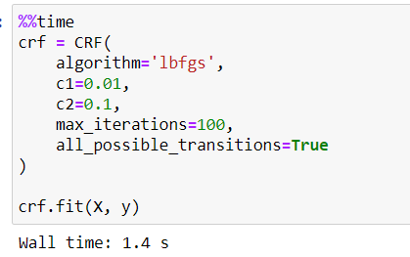
Training & Testing
Training
Let’s check some statistic information of our data:
880 sentences
Total 2,887 o label(s); 246 c label(s) and 109 a label(s)
Label=c (Car); Label=a (Accessories); Label=o (Others)
Below is the hyperparameters used in CRF training (more):
The testing ratio is 0.2 (80% of data is used for training; 20% of data is used for testing.)

Slide 16
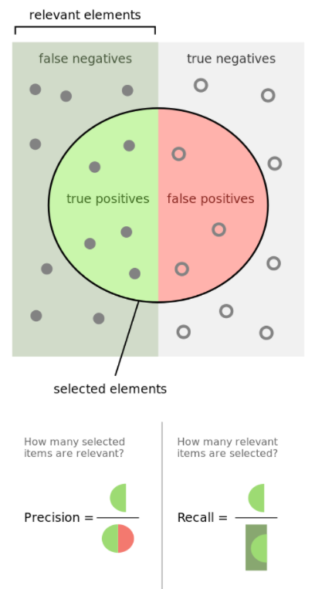
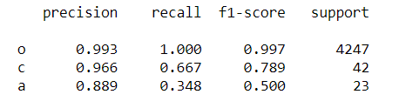
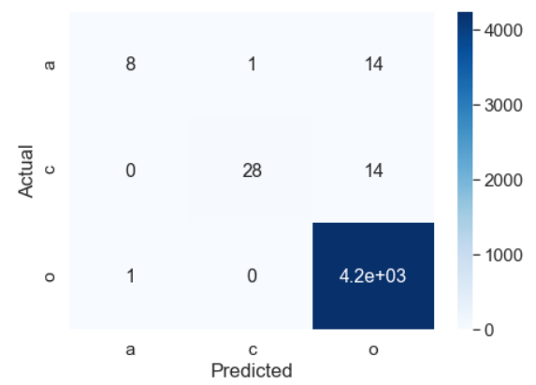
Training & Testing
Training
Model performance:
True Label as “o” being predicted as “a”

Slide 17
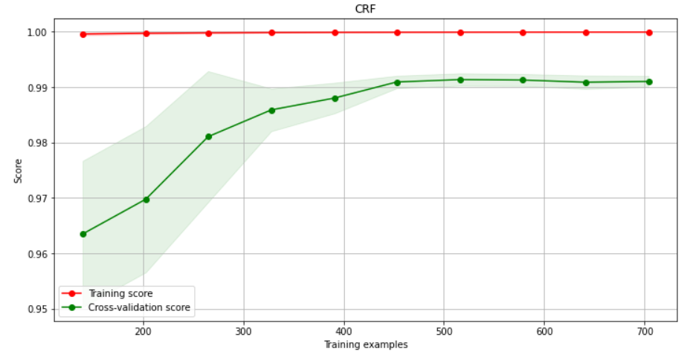
More data means better performance?
Training
accuracy
# training examples

Slide 18
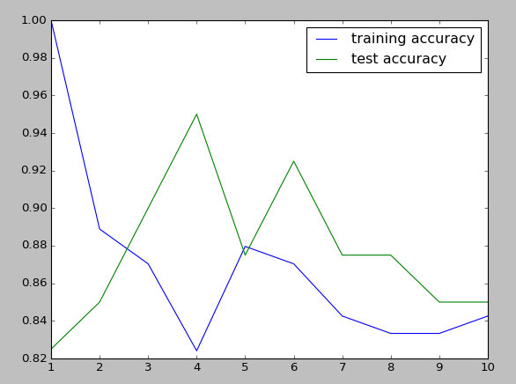
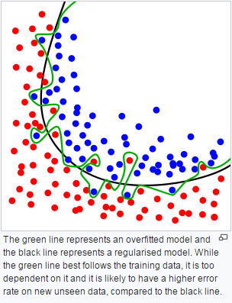
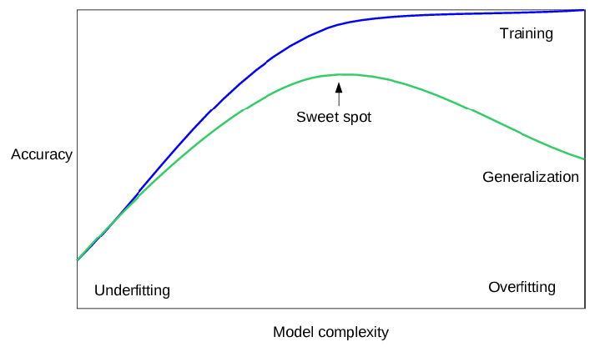
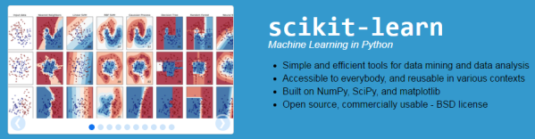
Learning From Data
Evaluation
Drawing chart sometimes will help you to select the optimization of parameters.

Slide 19
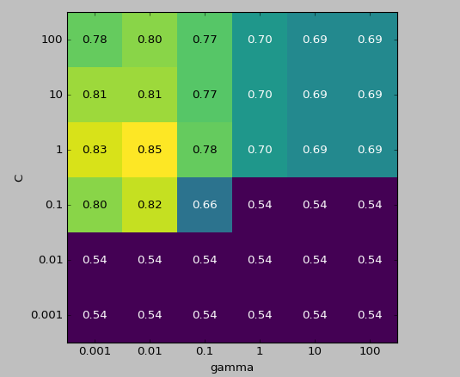
Learning From Data
Evaluation
Knowing the physical meaning of each parameters of the classifier you choose will help you to better understand the report:
A small gamma means a large radius for the Gaussian kernel, which means that many points are considered close-by.
A small C (regularization) means a very restricted model, where each data point can only have very limited influence.

Slide 20
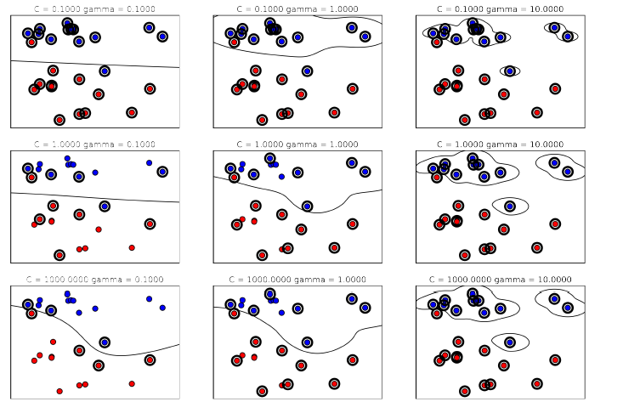
Learning From Data
Evaluation
More about gamma and C:
gamma ↑
C ↑

Slide 21
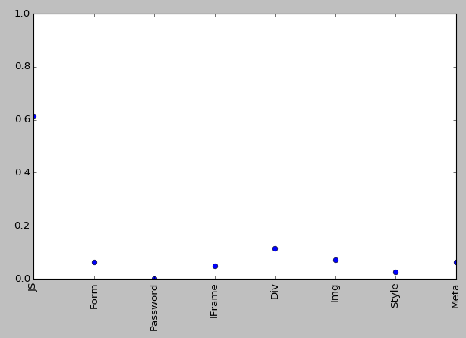
Learning From Data
Evaluation
Finally, it is also great to know the importance of each feature after training. It can help you to get rid of useless features and reduce the number of features:

Slide 22
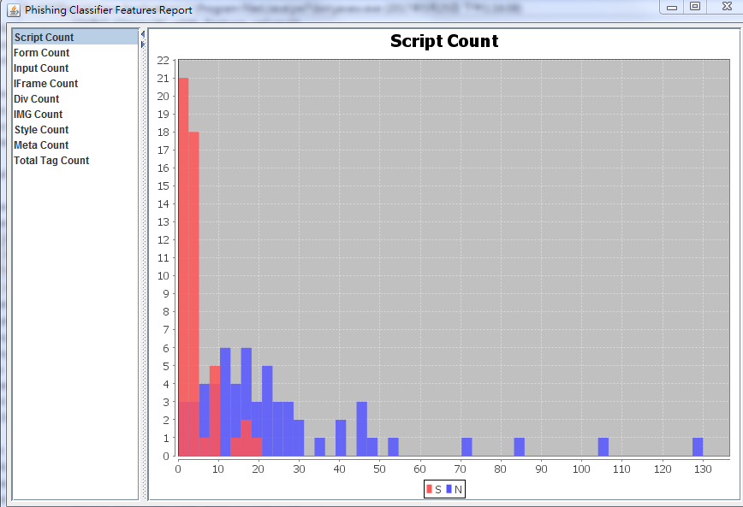
Learning From Data
Evaluation
Good example to be selected as feature:

Slide 23
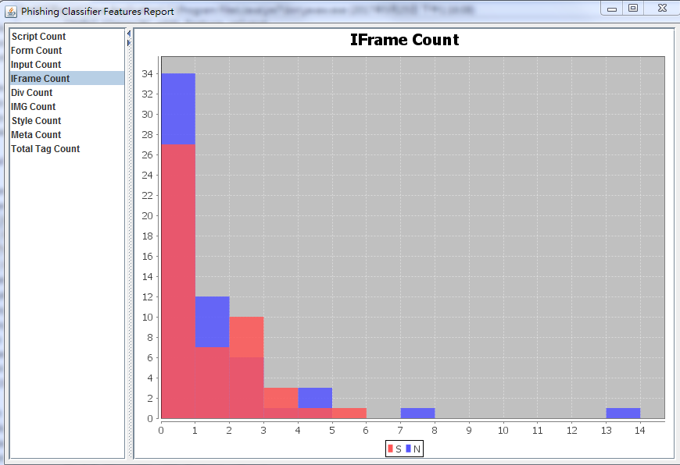
Learning From Data
Evaluation
Bad example to be selected as feature:

Slide 24
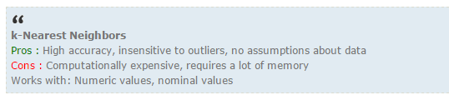
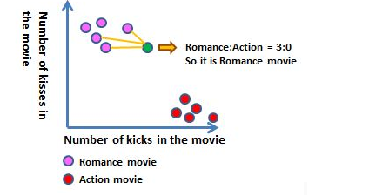
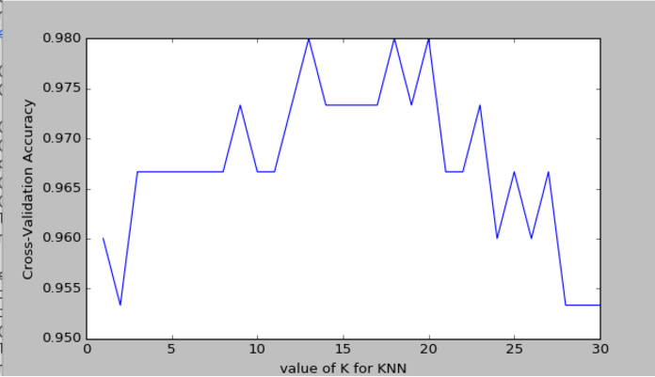
Learning From Data
Evaluation
Understand the parameter(s) of classifier model you select (KNeighborsClassifier here) to fine turn the model for optimization.
To know more about K-Means classification, you can refer to the post [ ML In Action ] Classifying with k-Nearest Neighbors

Slide 25
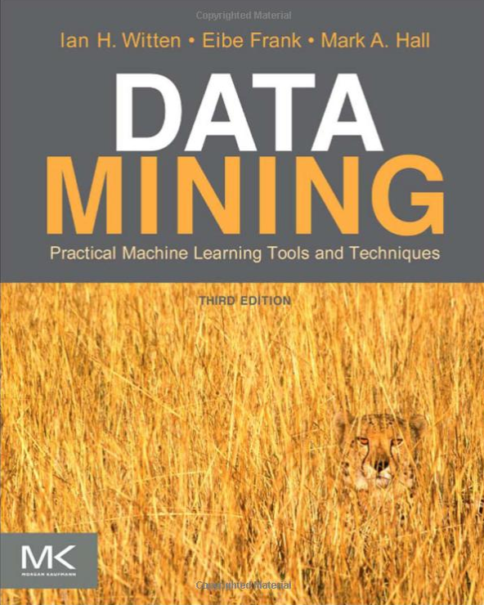
I want to learn the math/alg of ML
Amazon book
Dark ver pdf

Slide 26
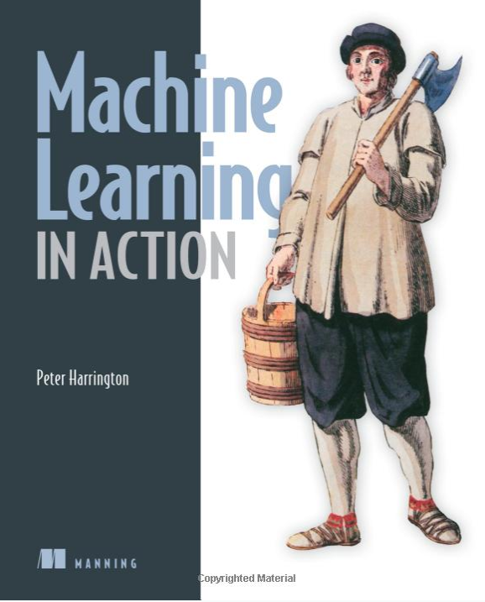
I want create ML toolkit by myself
Amazon book

Slide 27
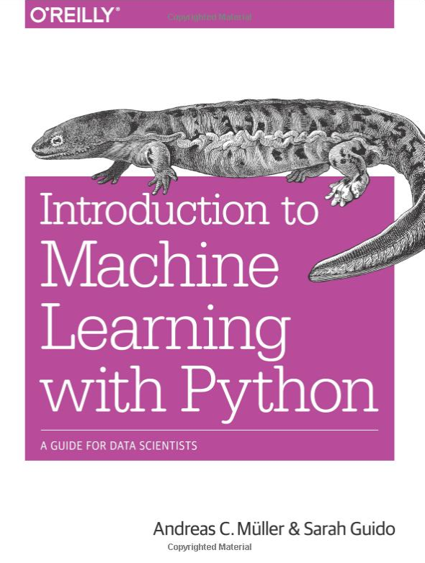
I want know how to use ML
Amazon book

Slide 28
Appendix
AE + AI: the way towards autonomous computers | Pierre Collet | TEDxUTTroyes
Course Introduction @ Machine Learning Foundations (機器學習基石)
Timo Honkela: A history of machine learning and neural networks research
What is machine learning?
What is Artificial Intelligence (or Machine Learning)?
Practical Machine Learning Tutorial with Python Intro

Slide 29
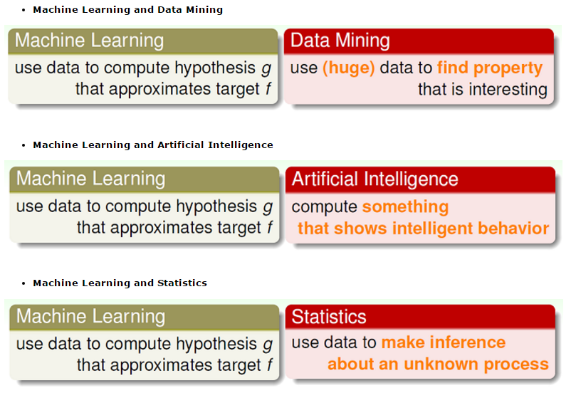

Slide 30
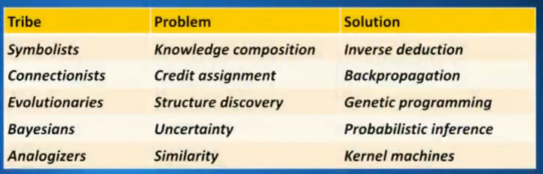
Pedro Domingos: "The Master Algorithm" | Talks at Google

